Slide 1
For Live Session: Linear Regression models
Unit 10
Carlos Estevez

Slide 2
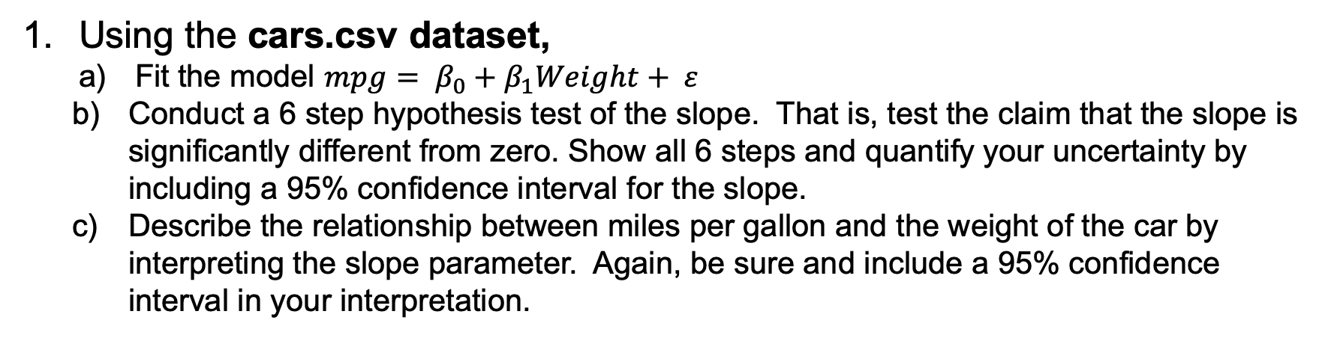
For Live Session: Question 1
Using the cars.csv dataset,
Fit the model $mpg= β_{0}+β_{1}Weight+ ε$
Conduct a 6 step hypothesis test of the slope. That is, test the claim that the slope is significantly different from zero. Show all 6 steps and quantify your uncertainty by including a 95% confidence interval for the slope.
Describe the relationship between miles per gallon and the weight of the car by interpreting the slope parameter. Again, be sure and include a 95% confidence interval in your interpretation.

Slide 3
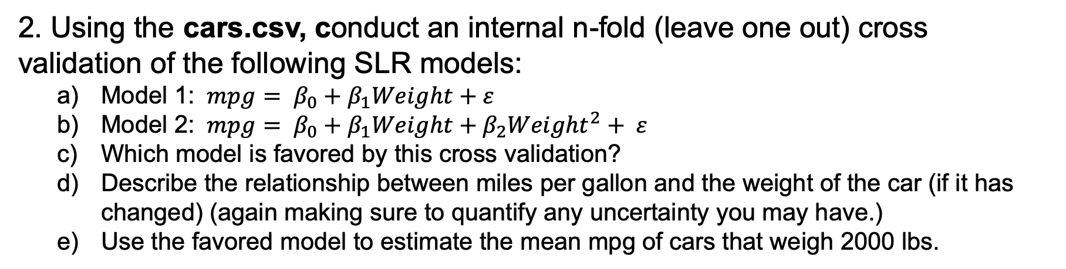
For Live Session: Question 2
2. Using the cars.csv, conduct an internal n-fold (leave one out) cross validation of the following SLR models:
Model 1: $mpg= β_{0}+β_{1}Weight+ε$
Model 2: $mpg= β_{0}+β_{1}Weight+β_{2}{Weight}^{2}+ ε$
Which model is favored by this cross validation?
Describe the relationship between miles per gallon and the weight of the car (if it has changed) (again making sure to quantify any uncertainty you may have.)
Use the favored model to estimate the mean mpg of cars that weigh 2000 lbs.

Slide 4
For Live Session: Question 3
3. Using the cars.csv dataset, We would like to assess the relationship (interpret slope parameter) between mpg and horsepower. Notice that some of the horsepowers are missing.
Impute (predict and insert) the missing horsepowers by fitting a regression model.
You may use any of the variables as regressors EXCEPT for mps (since we will later be using horsepower to predict mpg.)
Assess the relationship between the mpg and the slope. Make sure and include estimates of your uncertainty (ie. Confidence intervals.)
Use your model and imputed data to estimate the mean mpg for a car with 250 horsepower.

Slide 5
ANSWERS

Slide 6
For Live Session: Question 1
Using the cars.csv dataset,
Fit the model $mpg= β_{0}+β_{1}Weight+ ε$
Conduct a 6 step hypothesis test of the slope. That is, test the claim that the slope is significantly different from zero. Show all 6 steps and quantify your uncertainty by including a 95% confidence interval for the slope.
Describe the relationship between miles per gallon and the weight of the car by interpreting the slope parameter. Again, be sure and include a 95% confidence interval in your interpretation.

Slide 7
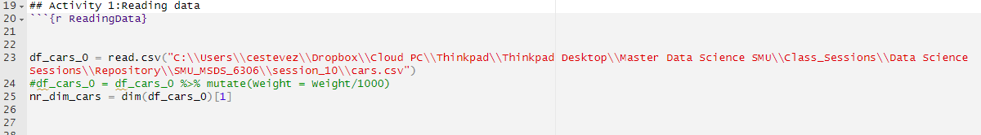
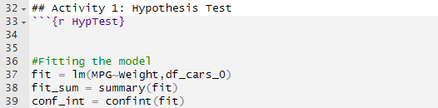

Question 1
Comments
Reading dataset
Fitting the model MPG vs Weight
Using the cars.csv dataset
Fit the model $mpg= β_{0}+β_{1}Weight+ ε$

Slide 8
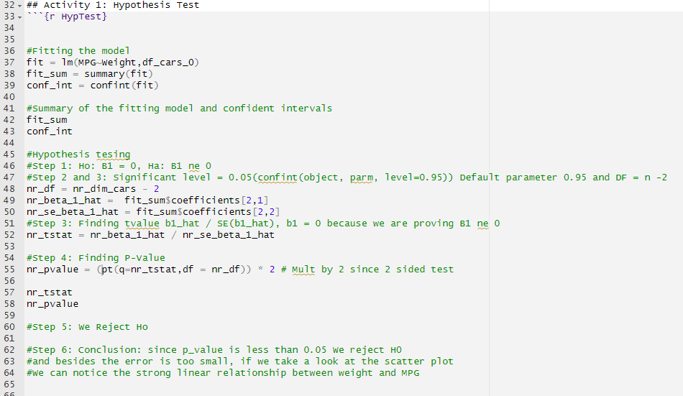
Question 1
Comments
Hypothesis test
Step 1: Ho: B1 = 0, Ha: B1 ne 0
Step 2 and 3: Significant level = 0.05(confint(object, parm, level=0.95)) Default parameter 0.95 and DF = n -2
Step 3: Finding tvalue b1_hat / SE(b1_hat), b1 = 0 because we are proving B1 ne 0
Step 4: Finding P-Value
Step 5: We Reject Ho
Step 6: Conclusion: since p_value is less than 0.05 We reject H0#and besides the error is too small, if we take a look at the scatter plot #We can notice the strong linear relationship between weight and MPG
b). Conduct a 6 step hypothesis test of the slope. That is, test the claim that the slope is significantly different from zero. Show all 6 steps and quantify your uncertainty by including a 95% confidence interval for the slope
T-Value = -29.73
P-Value = 2e-16

Slide 9
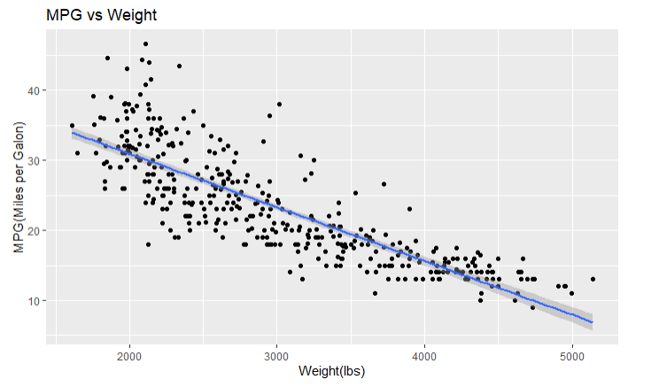
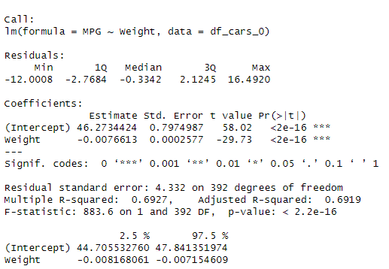
Question 1
Comments
There‘s linear negative relationship between Weight and MPG
Interpretation
Intercept = 46.27
Slope = -0.0076
It means that by each unit of weight the MPG decreases 0.0076
Confident interval
c) Describe the relationship between miles per gallon and the weight of the car by interpreting the slope parameter. Again, be sure and include a 95% confidence interval in your interpretation

Slide 10
For Live Session: Question 2
2. Using the cars.csv, conduct an internal n-fold (leave one out) cross validation of the following SLR models:
Model 1: $mpg= β_{0}+β_{1}Weight+ε$
Model 2: $mpg= β_{0}+β_{1}Weight+β_{2}{Weight}^{2}+ ε$
Which model is favored by this cross validation?
Describe the relationship between miles per gallon and the weight of the car (if it has changed) (again making sure to quantify any uncertainty you may have.)
Use the favored model to estimate the mean mpg of cars that weigh 2000 lbs.

Slide 11
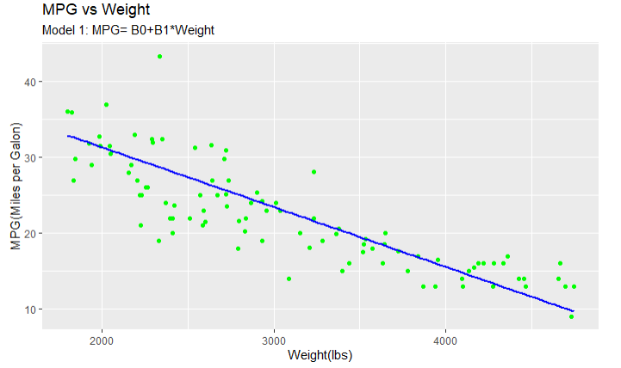
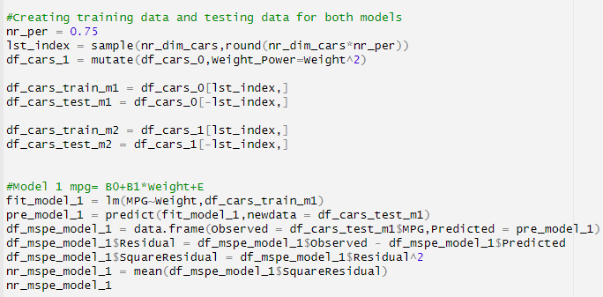

Question 2
Comments
Creating testing and training dataset
Fitting model 1
a) Model 1:$mpg= β_{0}+β_{1}Weight+ε$

Slide 12
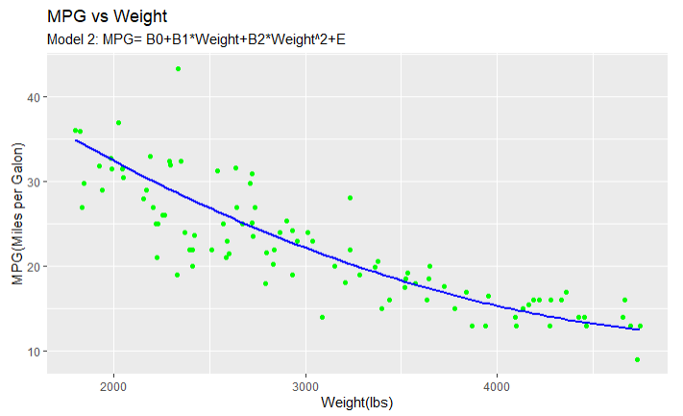
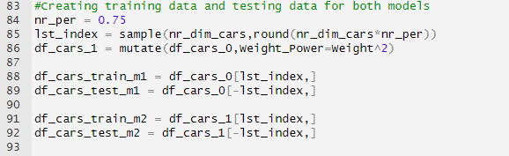
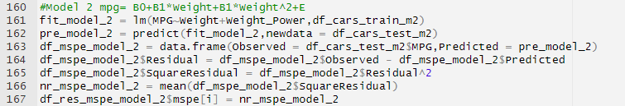

Question 2
Comments
Creating testing and training dataset model 2
Fitting model 2
b) Model 2:$mpg= β_{0}+β_{1}Weight+β_{2}{Weight}^{2}+ ε$

Slide 13
Question 2
Comments
As we can see from the plot model 2 is able to predict much better the MPG over 4000 lbs
c) Which model is favored by this cross validation? Model 2 is better

Slide 14
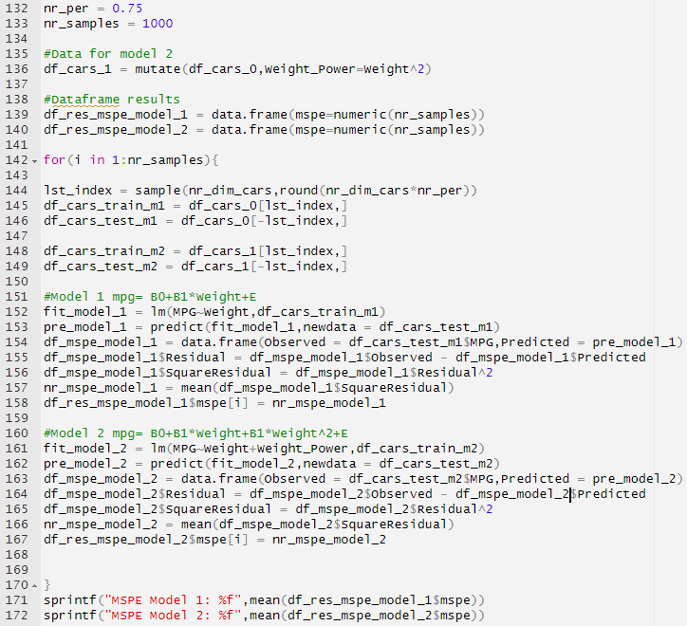

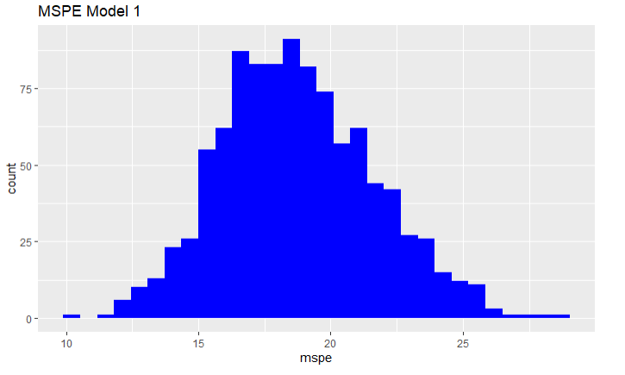
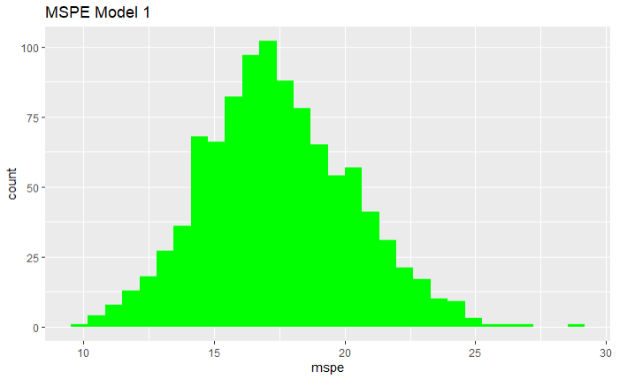
Question 2
Comments
We also creates an scenario of 1000 samples using the same sample size and the results favors model 2
MSPE calculation
c) Which model is favored by this cross validation? Model 2 is better

Slide 15

Question 2
Comments
In terms of the Model 1 the relationship between MPG and Weight is linear
When It comes to model the relationship is not linear because of the quadratic expression of the second term
Model and Prediction
d)Describe the relationship between miles per gallon and the weight of the car (if it has changed) (again making sure to quantify any uncertainty you may have.)
e)Use the favored model to estimate the mean mpg of cars that weigh 2000 lbs

Slide 16
Question 3
3. Using the cars.csv dataset, We would like to assess the relationship (interpret slope parameter) between mpg and horsepower. Notice that some of the horsepowers are missing.
a)Impute (predict and insert) the missing horsepowers by fitting a regression model.
b)You may use any of the variables as regressors EXCEPT for mps (since we will later be using horsepower to predict mpg.)
c)Assess the relationship between the mpg and the slope. Make sure and include estimates of your uncertainty (ie. Confidence intervals.)
d)Use your model and imputed data to estimate the mean mpg for a car with 250 horsepower.

Slide 17
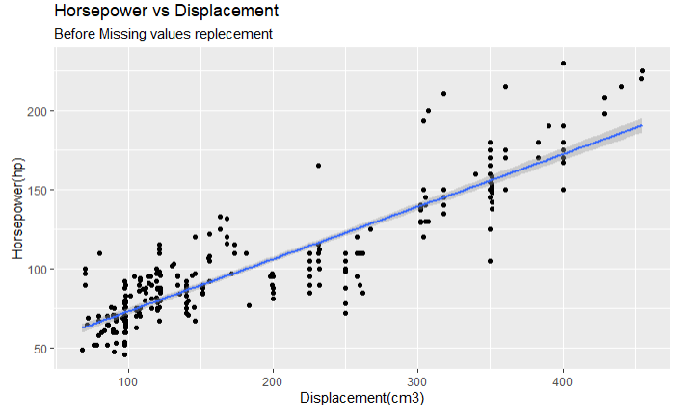
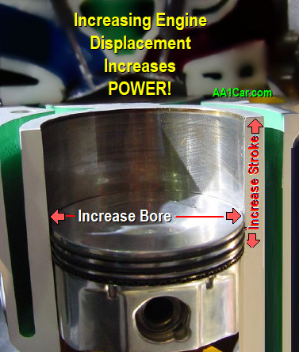
Question 3
Comments
We will use the engine displacement in order to perform imputation for horsepower
Definition:
“Engine displacement is a determining factor in the horsepower and torque that an engine produces, as well as how much fuel that engine consumes”
A and b)Impute (predict and insert) the missing horsepowers by fitting a regression model

Slide 18
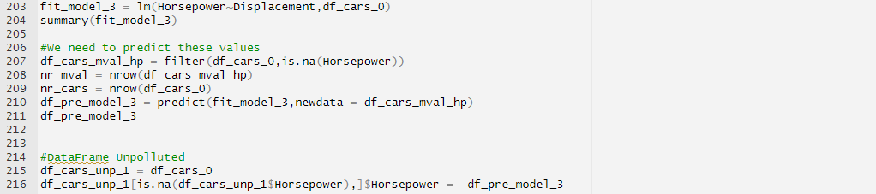
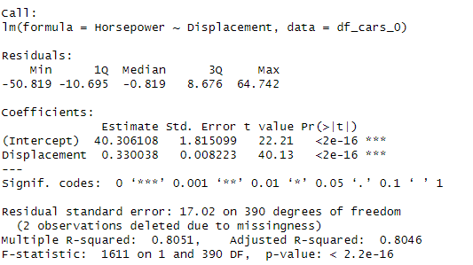
Question 3
Comments
Fitting the model using Displacement and Horsepower
Results: The error is very low which means the model is very good
A and b)Impute (predict and insert) the missing horsepowers by fitting a regression model

Slide 19
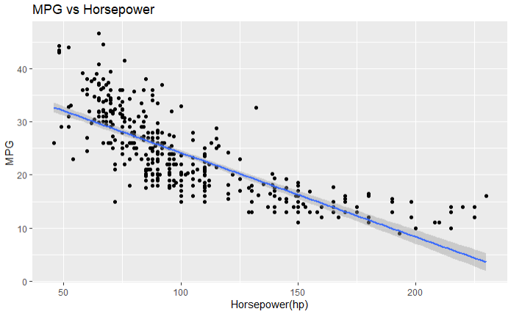
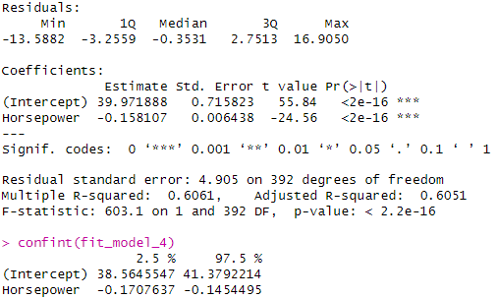
Question 3
Comments
There’s a negative linear relationship between MPG and Horsepower
Results and Confident intervals
c)Assess the relationship between the mpg and the slope. Make sure and include estimates of your uncertainty (ie. Confidence intervals.)

Slide 20
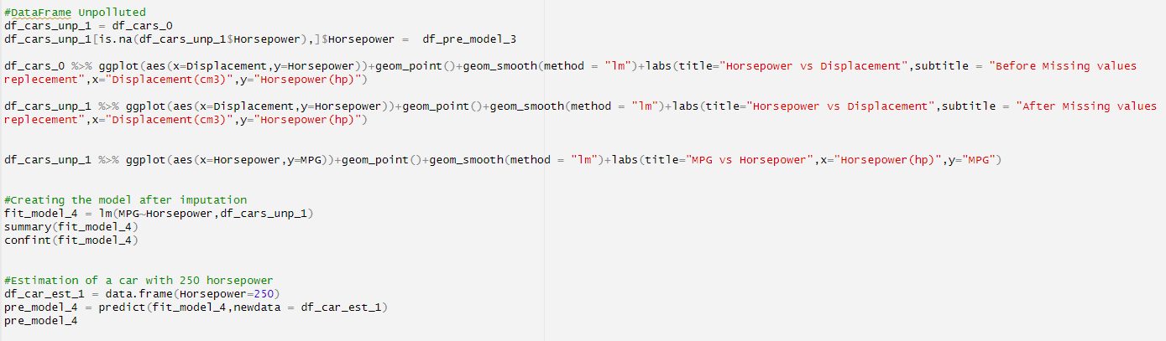
Question 3
Comments
Using unpolluted data by replacing the NA values with the prediction of the imputated values(Displacement and Horsepower)
Fitting the model with the new dataset
c)Assess the relationship between the mpg and the slope. Make sure and include estimates of your uncertainty (ie. Confidence intervals.)

Slide 21
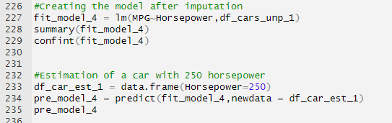
Question 3
Comments
Fitting the model
Creating the scenario
Displaying the results
d)Use your model and imputed data to estimate the mean mpg for a car with 250 horsepower:
Result: 0.445 MPG

Slide 22
Takeaways
It was a great experience using SLR for different scenarios including prediction and imputation. In addition to that, it was very useful to learn how to use other predictors using MLR
Question
None

